Slide 1


CS 539: MACHINE LEARNING DISTRACTED DRIVER DETECTION
Guidance: Prof. Kyumin Lee
Team:
Vrushabh Desai
Rishabh Chadha
Kratika Agrawal

Slide 2
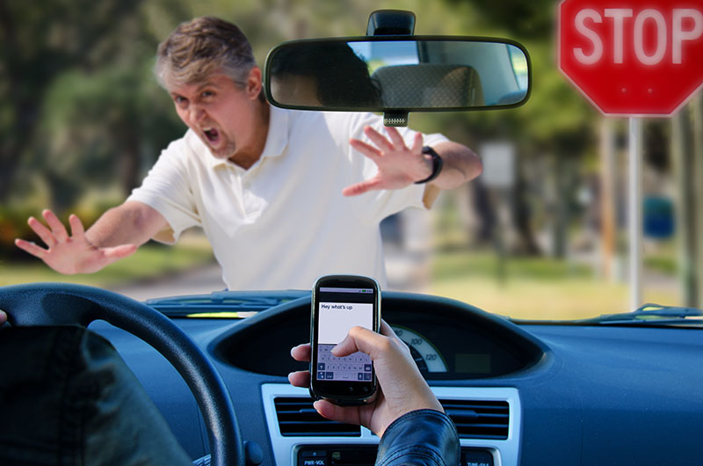
MOTIVATION

Slide 3
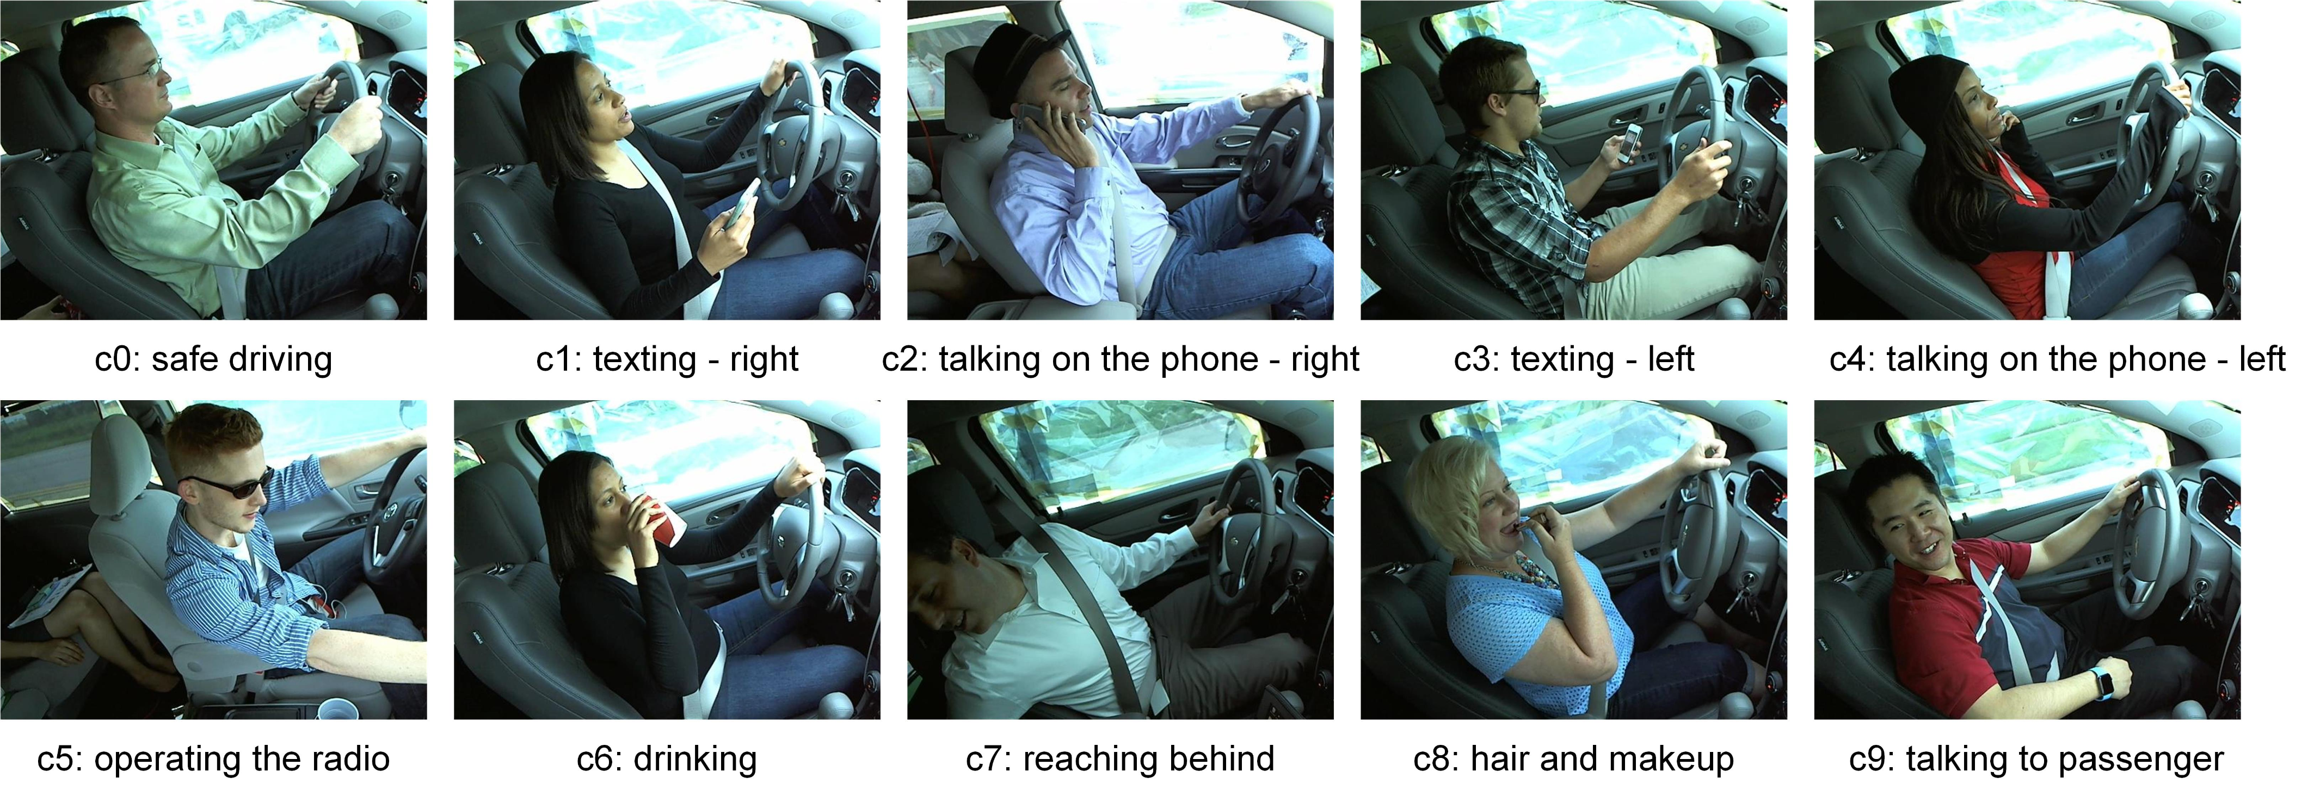
INTRODUCTION
Goal: To detect if the diver is driving safe or performing any activity
Classify drivers’ activity into 10 categories

Slide 4
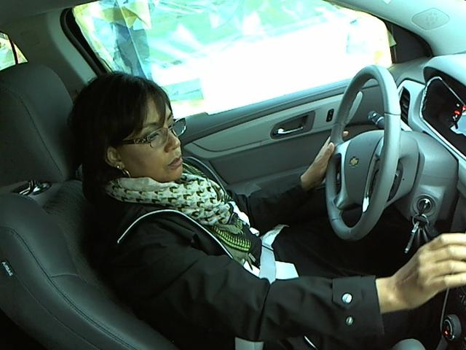
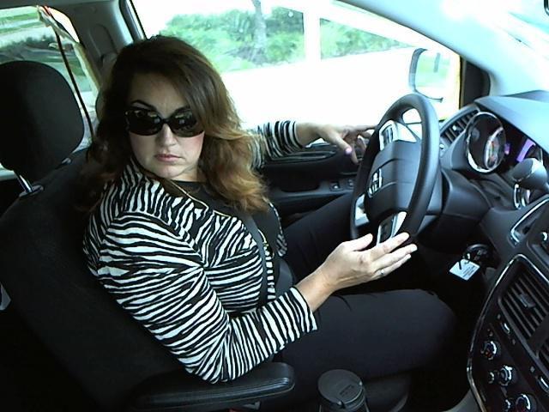
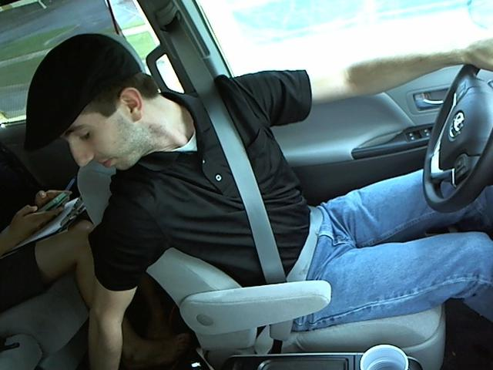
DATASET
Distracted Driver Images from Kaggle State Farm Competition
Includes 22.5k labelled images with approx. 2.2k images belonging to each class.
640x480 RGB images
70k unlabelled Images

Slide 5
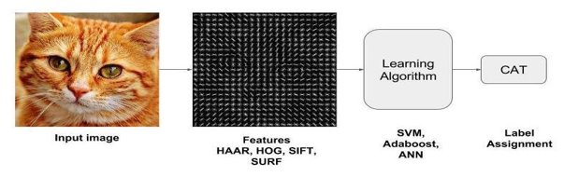
FEATURE extraction techniques
Image classification is best done by extracting features such as
Pixel
HOG
Sobel
Clustering

Slide 6
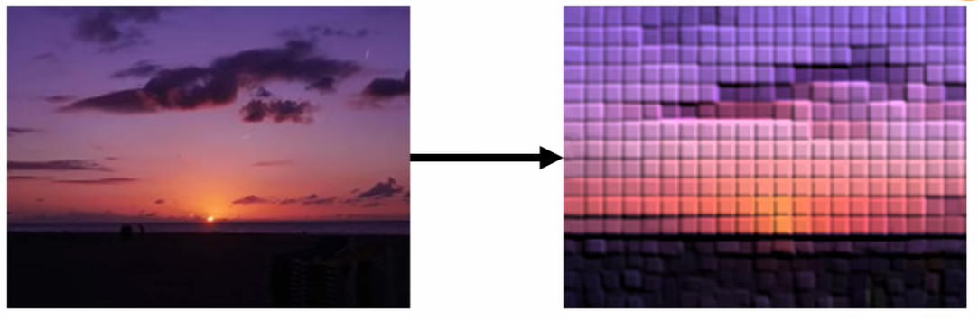
PIXELS AS FEATURES
Resize image to 64x64 RGB image
Stacked all the RGB pixels values in a single feature vector of size 64x64x3

Slide 7
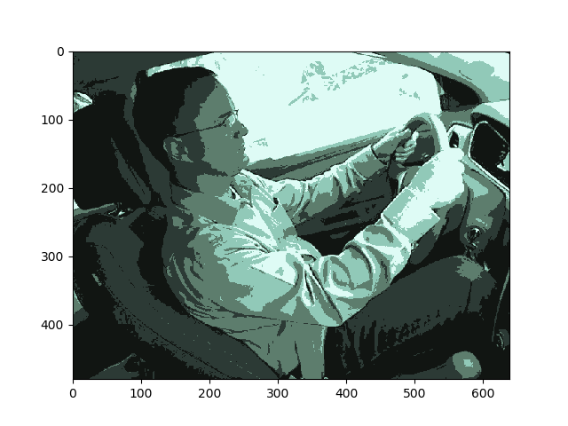
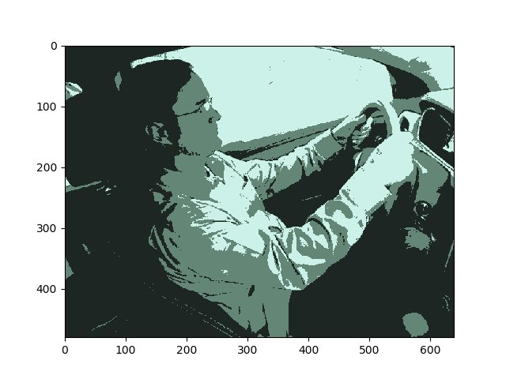
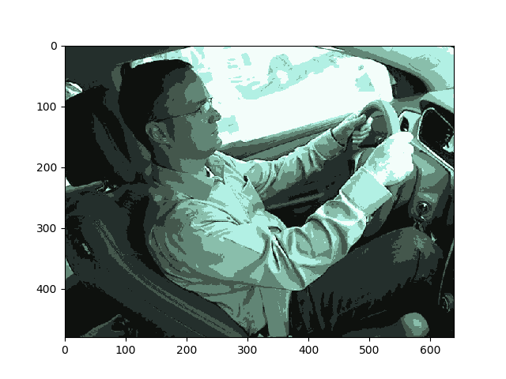
CLUSTERING
Resize image to 64x64 RGB image
Implement K-means clustering on each image with k=3 (in our case)
Stack cluster features to create feature matrix

Slide 8
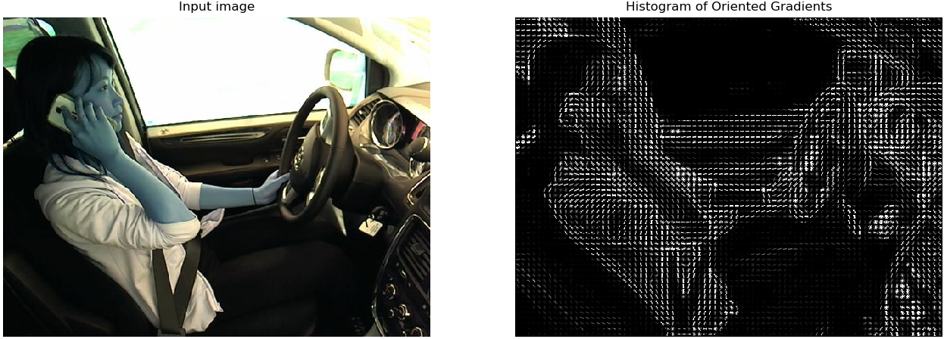
HOG Feature Descriptor
Counts occurrences of gradient orientation in localized portions
Stack HOG gradient features to generate a feature matrix

Slide 9
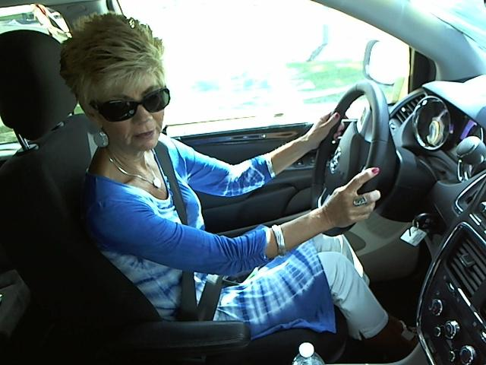
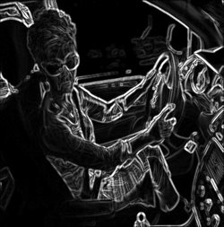
Sobel Edge Descriptor
Resize image to 64x64 RGB image
Obtained edges using Sobel gradient in X and Y direction
Stacked object edges as feature vector

Slide 10
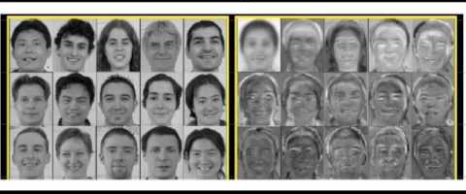
PRINCIPAL COMPONENT ANALYSIS
The images are resized to 64 x 64 RGB images
Individual pixels are used as features.
Used PCA for dimensionality reduction
Number of features reduced from 12,288 to 930 on retaining 95% variance.

Slide 11

ALGORITHM IMPLEMENTATION
Split labelled data set into 75% Train, 15% Validation and 10% Test data.
Used Scikit-learn to implement following algorithms:
Decision Tree
Support Vector Machine
Random Forest
Implemented 2 Layer fully connected Neural Network
Implemented Convolution Neural Network using Tensorflow

Slide 12
1. Support Vector Machine
Implemented SVM on HOG features of the image
Used kernels : Linear and Gaussian
Varied value of "C" in order to obtain better accuracy
Train Data | Accuracy
64x64 RGB Image | 79.8%
HOG FDs | 82.2%
Notes:
Implemented SVM on HOG features of the image
Used kernel=linear for Linear SVM implementation
Used kernel=rbf for Gaussian SVM implementation
Varied value of "C" in order to obtain better accuracy
Achieved xx% Accuracy with Gaussian SVM with C=1.

Slide 13
2. DECISION TREE
Train Data: Gray images, RGB images, PCA features, Sobel Edges
Tried Pruning
Image Resolution | Accuracy
Gray Scale Image | 49.6%
PCA | 80.2%
Sobel Egde Images | 81.9%
64x64 RGB Image | 87.1%
Notes:
Implemented SVM on HOG features of the image
Used kernel=linear for Linear SVM implementation
Used kernel=rbf for Gaussian SVM implementation
Varied value of "C" in order to obtain better accuracy
Achieved xx% Accuracy with Gaussian SVM with C=1.

Slide 14
3. Random Forest
Scikit-Learn Library
Different number of trees
Train data: Gray images, RGB images & K-means clustered images
Train data | Accuracy
64x64 Gray Image | 78.1%
K-means clustered | 77.3%
RGB Image | 89.4%
Notes:
Bootstrap=True (default)
Implemented Random Forest Classifier of Scikit-learn library
Tried different number of trees to obtain better results
Trained model on RGB images and K-means clustered dataset
Achieved 93% Accuracy with Random Forest model with number of trees = 100

Slide 15
4. 2-Layered Neural Network
Keras library
Different combinations of number of neuron units
Varied activation functions on layers
Image Resolution | Accuracy
64x64 Gray Scale Image | 88.6%
64x64 RGB Image | 92.7%
Notes:
Used Keras library along with Python 3 to implement 2 layer fully connected Neural Network
Trained model 64x64 sized RGB images
Tried different combinations of number of neurons in hidden units
Used varied activation functions on layers
Achieved xx% Accuracy with 2NN

Slide 16
5. Convolution Neural Network
Trained model on 100x100 sized RGB images data set using TensorFlow.
Explored various hyper parameters such as:
Number of Kernels and Kernel Size in convolution layer
Number of Neurons in hidden layer
Number of Epochs
Optimizer: Adam and SGD
Learning Rate in SGD
Number of CNN Layers and Hidden Layers

Slide 17
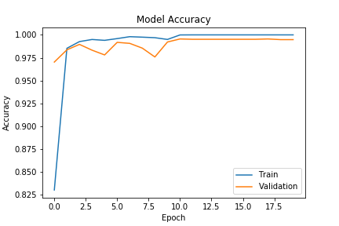
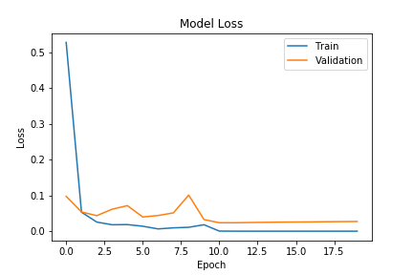
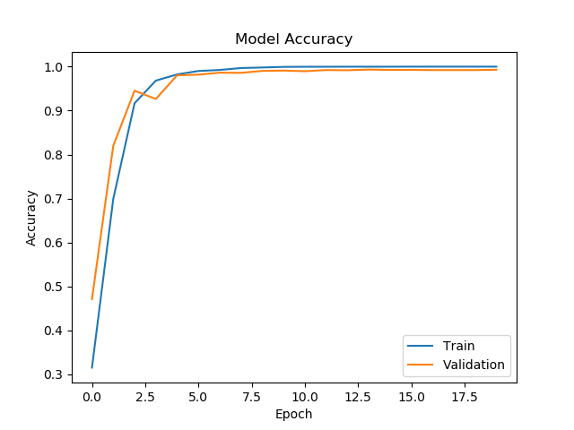
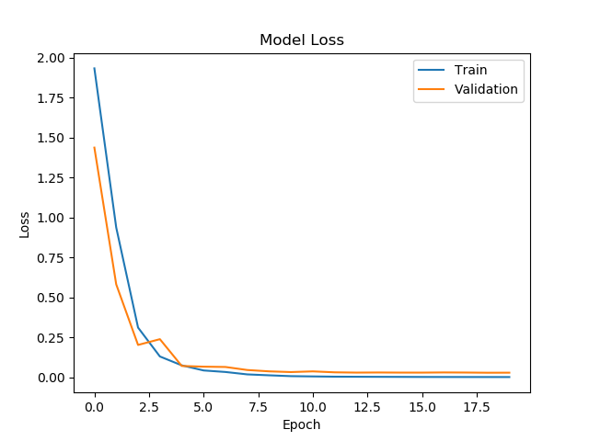
Optimizer : ADAM vs SGD
Test Accuracy:
Adam: 97.89%
SGD (Learning rate = 0.01 ): 97%
Adam generalize poorly compared to SGD, but it converge faster compare to SGD

Slide 18
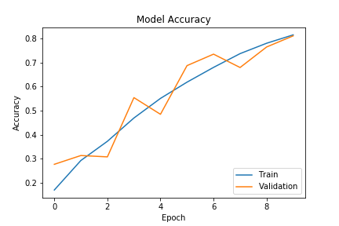
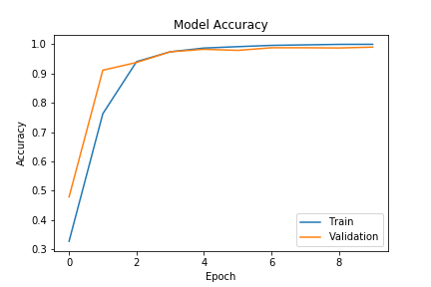
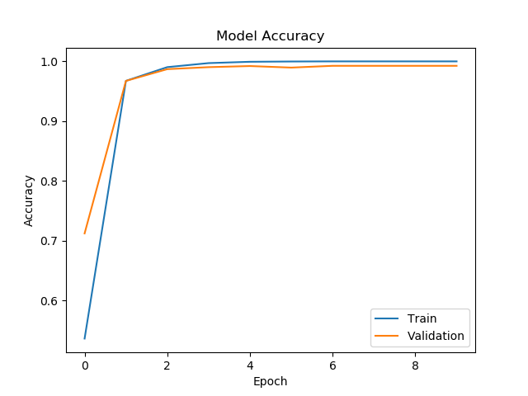
SGD: learning rate
All the model hyper parameter are constant varying learning rate.
Learning Rate: 0.001
Test Accuracy: 81%
Learning Rate: 0.01
Test Accuracy: 96.8%
Learning Rate: 0.1
Test Accuracy: 97.32%

Slide 19
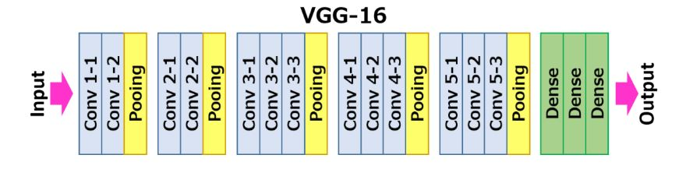
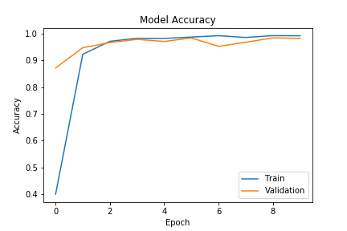
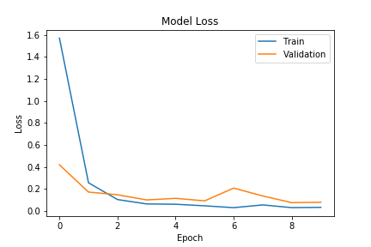
VGG16 architecture
VGG16 is used for Deep Convolutional Networks for Large-Scale Image Recognition.
Test Accuracy: 98.28%
VGG16 model generalizes very well

Slide 20
EVALUATION
The best results were obtained using a CNN with VGG16 architecture.
Model | Accuracy | Generalized Accuracy
Decision Tree | 87.1% | 41.6%
Random Forests | 89.4% | 43.8%
SVM | 82.2% | 60.2%
Neural Network | 92.7% | 42%
CNN | 98.28% | 64.3%

Slide 21
Key Takeaways
Feature extraction is an important step.
Selection of model
Good features are needed for Dimensionality Reduction
Generalized accuracy depends on distribution of real-world data in comparison to test data.

Slide 22
FUTURE WORK
Explore more feature extraction techniques
Combine various feature vectors for Image Representation
Implement modern Deep Neural Network Architectures
Recurrent Neural Nets (RNN)

Slide 23
THANK YOU!!!

